Slide 1
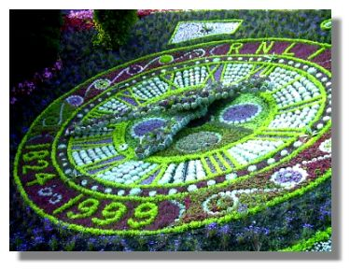
Biological timing responses of plants

Slide 2
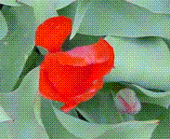

Circadian rhythms
Photosynthesis occurs during the day
Some flowers open and close at certain times of the day or night
Some flowers follow the sun (e.g. sunflowers)
Nectar and perfume may be produced at a certain time of day or night
Cell division may occur at the same time each day

Slide 3
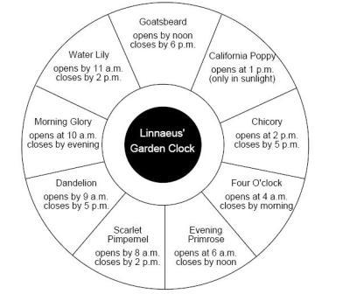
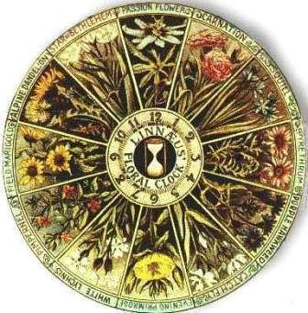
Floral clock
Linnaeus devised a clock using flowers that opened at different times of the day

Slide 4
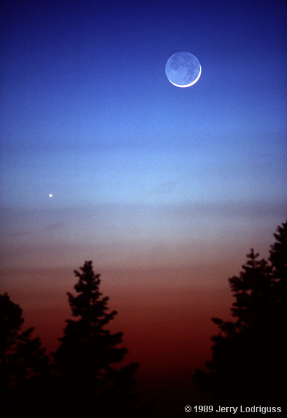
Circalunar Rhythms
People have claimed to have found rhythms in germination of seeds and growth of plants that show a rhythm related to the Moon phases
Most human cultures have “planting by the Moon” calendars.

Slide 5
Circatidal rhythms
Tides affect the lifecycles of marine algae (Which are not true plants)
Many seaweeds release sperm and eggs into the water only at the highest tides at certain times of the year.

Slide 6
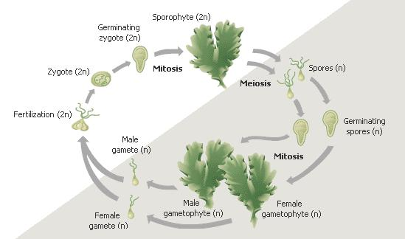
Sea lettuce life cycle

Slide 7
Circannual Rhythms
Flowering
Dormancy (of both plants and seeds)
Leaf abscission (leaf fall)
Vernalisation of seeds
Growth patterns

Slide 8
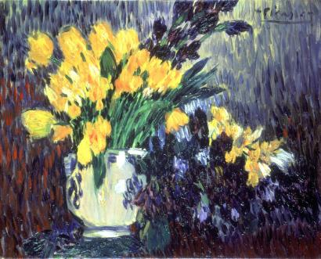
Flowering of plants

Slide 9
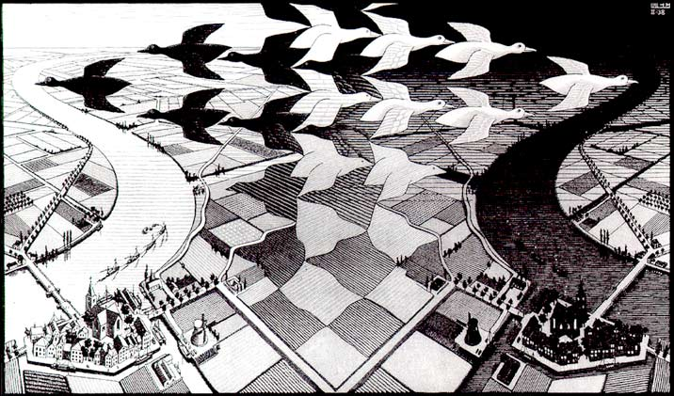
Photoperiodism
Responses to changes of day length
Really a response to length of darkness
Depends on a critical night length, but usually we talk about the critical day length.

Slide 10
Short-day plants
Require a short day and a long night
Flower if photoperiod is less than a certain critical length
E.g. if a species has a 10-hour critical photoperiod, it will flower only if it has an unbroken period of dark longer than14 hours (24 – 10 hours)
These flower in autumn, winter or early spring.

Slide 11
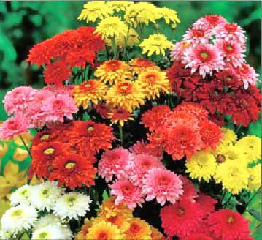
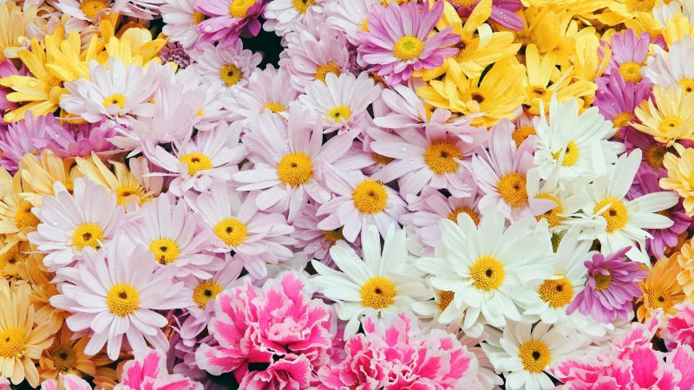
Chrysanthemums

Slide 12
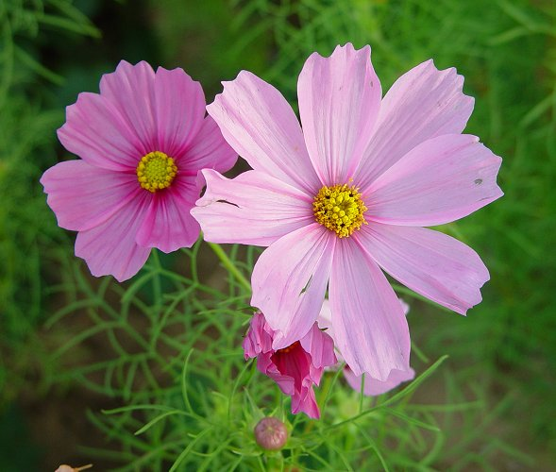
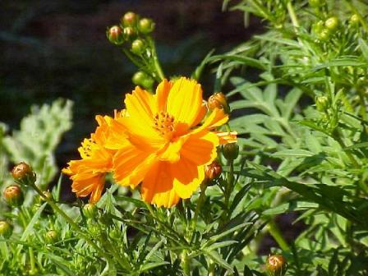
Cosmos (Cosmo daisies)

Slide 13
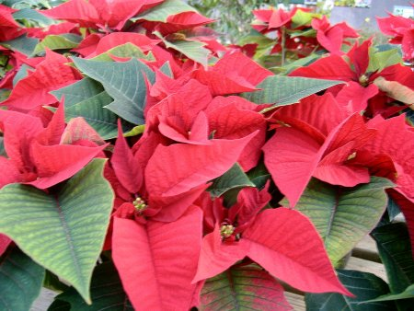

Pointsettias

Slide 14
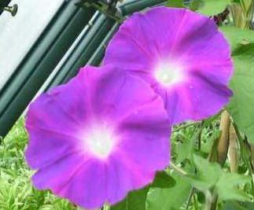
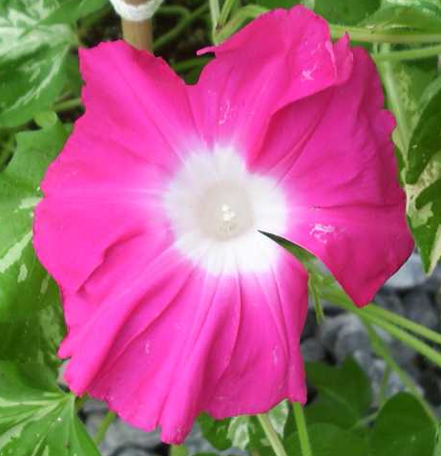
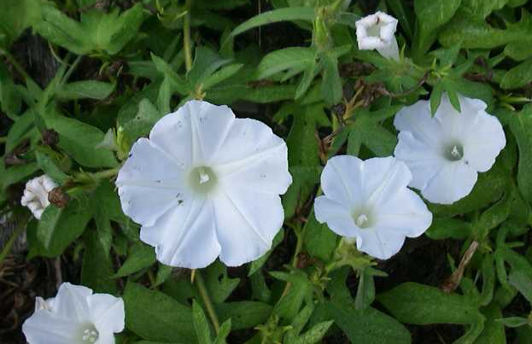
Japanese morning glory

Slide 15
Long-day plants
Require a long day and short night
Photoperiod must exceed a certain critical length for flowering to occur (short or interrupted night)
Flower in summer

Slide 16
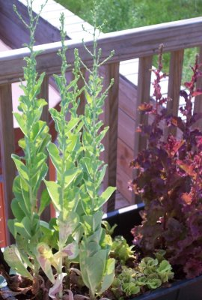
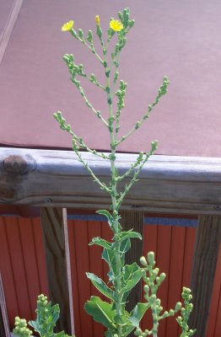
Lettuce

Slide 17
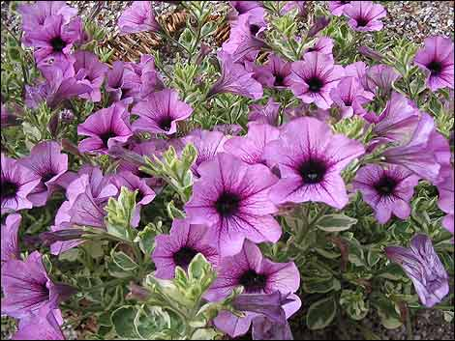
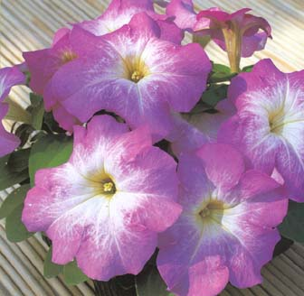
Petunias

Slide 18
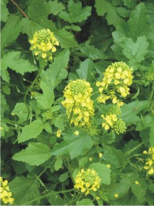
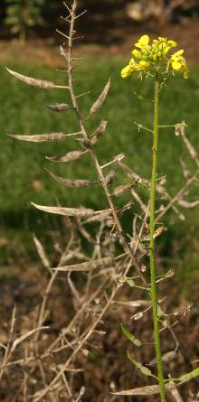
White mustard

Slide 19
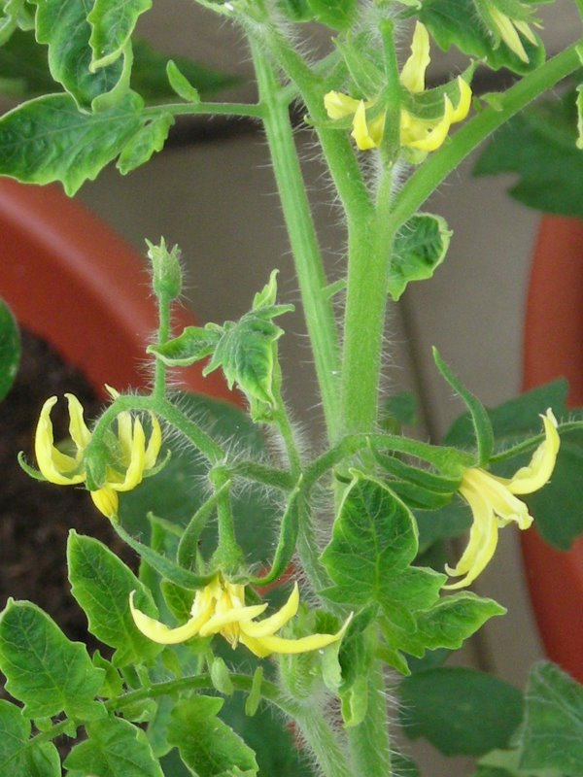
Day neutral plants
Flowering time not much affected by day length
E.g. tomato

Slide 20
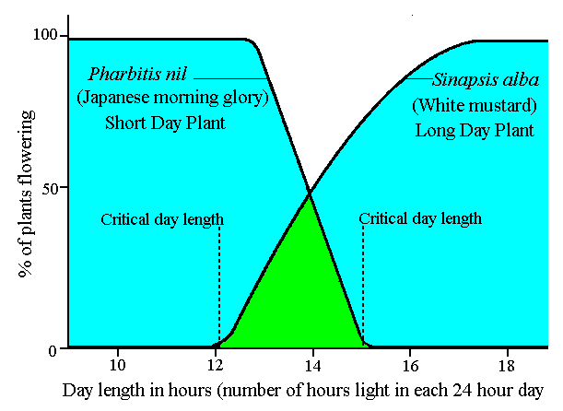
The effect of day length on flowering
Long day plant flowers only when day length exceeds the critical value (12h)
Short day plant flowers only when the day length falls below a critical value (about 15h)

Slide 21
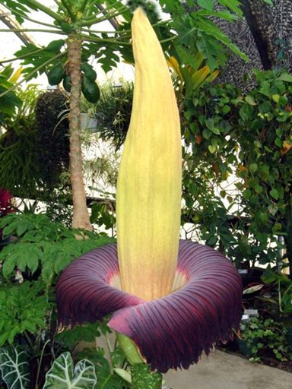
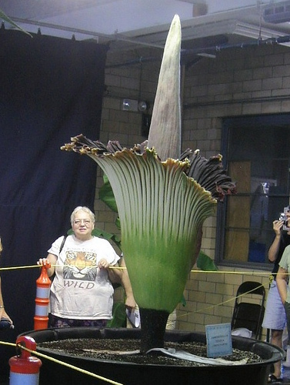

NOTE:
Temperature, moisture, soil nutrients and crowding may affect the flowering time of ANY plants. E.g. Sumatran corpse flower Titan arum -
The end

